Slide 1
The Harder You Try….
Brian Locke
PGR 10-20-2022

Slide 2
Case: 60M Veteran from ID to establish in VA pulmonary clinic due to recurrent infections, tracheostomy, and dyspnea.
Played football in high school – no limitation
Diagnosed with asthma during his 20s while in the military. Had exacerbations leading to ED visits. Inhalers helped dramatically.
Heavy artillery in Bosnia & Iraq. 23 years of service. +burn pits and other fumes (and dusts)
Diagnosed with sleep apnea. On PAP

Slide 3
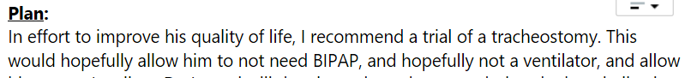
Case: 60M Veteran from ID to establish in VA pulmonary clinic due to recurrent infections, tracheostomy, and dyspnea.
Early 2010s – living in ID. Several admissions for respiratory failure.
2019 referred to National Jewish. Collapse and peri-respiratory arrest during pulmonary function tests. Intubated in PFT lab with reportedly normal respiratory mechanics immediately after.
Referred to U of U. Tracheostomy placed by local expert for laryngospasm (not noted on laryngoscope)
Ongoing dyspnea, coughing paroxysms after tracheostomy placed. “Airway inspected during forced expiration and coughing with mild dynamic airway collapse observed.”

Slide 4
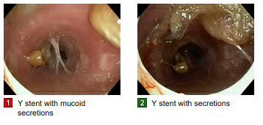
Case: 60M Veteran from ID to establish in VA pulmonary clinic due to recurrent infections, tracheostomy, and dyspnea.
5/2021 Subsequent bronchoscopy reveals severe anterior-posterior trachea-bronchial collapse. TBM diagnosed
5-10/2021 – silicon Y-stent placed. Symptoms improve.
However, has recurrent episodes of mucus plugging in the Y-stent lead to severe, acute respiratory failure requiring intubation and therapeutic suctioning.
Y-sent has to be removed (9/2021)
Continues on BPAP through
tracheostomy when at rest or
asleep for ‘sleep apnea’

Slide 5
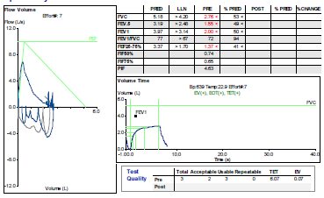
Case: 60M Veteran from ID to establish in VA pulmonary clinic due to recurrent infections, tracheostomy, and dyspnea.
Given occupational exposure and ’restrictive spirometry’, undergoes lung biopsy to evaluate for burn-pit lung
7/2017: Not acceptable/repeatable: TET, unable to obtain inspiratory loop.
Robotic LUL&LLL Wedge Resection shows: ‘MILD CHRONIC BRONCHIOLITIS, SCATTERED INTRA-ALVEOLAR PIGMENTED MACROPHAGES, AND MODERATE TO FOCALLY SEVERE MYOINTIMAL THICKENING OF SMALL ARTERIES ’ Rare carbon-pigment deposition, rare hemosiderin-laden macrophages. No granulomas, no fibrosis or muscular hypertrophy. No evidence of constrictive bronchiolitis. No polarizable material notded. No cellular interstitial infiltrates.
Notes:
LEFT LUNG, UPPER LOBE, WEDGE RESECTION: - MILD CHRONIC BRONCHIOLITIS, SCATTERED INTRA-ALVEOLAR PIGMENTED MACROPHAGES, AND MODERATE TO FOCALLY SEVERE MYOINTIMAL THICKENING OF SMALL ARTERIES - SEE COMMENTS 2. LEFT LUNG, LOWER LOBE, WEDGE RESECTION: - MILD CHRONIC BRONCHIOLITIS, RARE NON-SPECIFIC SCARRED AIRWAY, SCATTERED INTRA- ALVEOLAR PIGMENTED MACROPHAGES, AND MODERATE TO FOCALLY SEVERE MYOINTIMAL THICKENING OF SMALL ARTERIES - SEE COMMENTS "Other minor findings include rare carbon pigment deposition around airways, a focal non-specific scar (likely scarred small airway) with associated carbon deposition, rare more coarsely pigmented intra-alveolar macrophages, and rare small clusters of intra-alveolar hemosiderin-laden macrophages. No granulomas are identified. The airways do not appear to have any significant subepithelial fibrosis or muscular hypertrophy. No evidence of constrictive bronchiolitis (CB) is seen on multiple levels examined. The rare non-specific scar which likely represents a scarred small airway is more in keeping with a random injury, perhaps due to this patient's known past infections, rather than a diffuse CB given the absence of features of the latter on multiple sections. No polarizable material ?is noted. No significant cellular interstitial infiltrates are noted (confirmed by CD3 and CD20 immunostains).
The history of inhalational exposure to burn pits while on deployment is noted. This exposure is an appealing possible unifying theory for the pigment deposition, chronic bronchiolitis and arteriopathy seen in this case. However, the absence of features of constrictive bronchiolitis (CB) might argue against this possibility although I suppose one might argue that sampling missed CB. Correlation with clinical and imaging findings is suggested. ? "

Slide 6
Case: 60M Veteran from ID to establish in VA pulmonary clinic due to recurrent infections, tracheostomy, and dyspnea.
Continues to have copious mucus secretions requiring around the clock secretion suction (wakes up at night to suction).
Hospitalized for COVID respiratory failure and superimposed bacterial pneumonia.
Has grown acinitobacter (R to zosyn), Enterobacter (R to unasyn), Psuedomonas (non aerogunosa), serratia (R to CTX), aspergillus fumigatus,
Recurrent antibiotic course as outpatient through PICC – ertapenem, micafungin 4-6 weeks.
Steroid dependent, 10mg daily but q1-2 month 40mg prednisone courses for exacerbations.
These have not helped.

Slide 7
Case: 60M Veteran from ID to establish in VA pulmonary clinic due to recurrent infections, tracheostomy, and dyspnea.
9/2021 Consultation with thoracic surgeons re: tracheal reconstruction
High risk surgery given recurrent pulmonary infections, high risk for peri-operative respiratory failure.
‘Would like for XXX to have a good 6 months with stability: improvement and no hospitalizations and then discuss proceeding with surgical intervention.’
After discussing risks of harms and chance of benefit, opts against

Slide 8
Other past medical history
PMHx: severe PTSD. ‘HFpEF’, paroxysmal AFib, GERD, Hypothyr
Surgical history: Surgical tracheostomy 2019, surgical lung biopsy 2020, AF ablation 2014. Thyroidectomy 2014 (apparently due to concern for tracheal compression), Neck Fusion C6-7 (2014)
Meds: roflumilast, triple inhalers, 9% saline, anti-histamine, clonazepam for anxiety, flecainide, apixaban, torsemide, omeprazole, spironolactone, amitiptylene, LT4
Social: lives in rural ID w/ girlfriend. Medically retired. Lifetime nonsmoker / non-vaper.

Slide 9
Exam:
BMI 40
8-0 uncuffed XLT trach in place. Able to speak in full sentences with occlusion of the tracheostomy. BPAP adapter fits well. Using humidified trach mask (via AIRVO). Whitish sputum suctioned. Mild purulent material at stoma
Regular rhythm without murmurs. Appears euvolemic.
Tachypneic (RR 40-60). 2-3 word dyspnea. ‘Guppy breathing’
Absolutely cannot lie flatter than 30 degrees, regardless whether on BPAP.

Slide 10
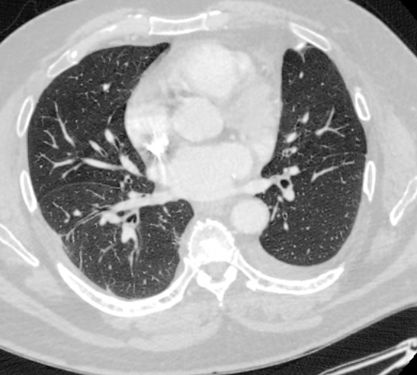
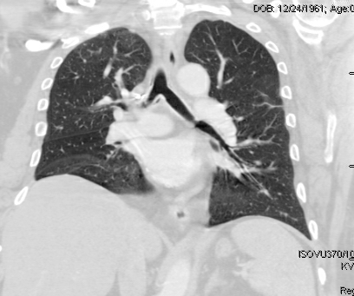
Workup:
TTE: moderately enlarged LA, but normal LVEF, normal E/e’, normal TAPSE, normal RV function, collapsible IVC.
CT Scan:

Slide 11
Serologic Testing
IgE 1142
Aspergillus specific IgE 5.31
Aspergillus IgG negative
Aspergillus from respiratory culture
Eos 290 on prednisone 10mg (recent 40mg)
HCO3- always 22-24
pH, PaCO2, PaO2 always normal (uses o2 via Airvo for humidification and dyspnea)

Slide 12
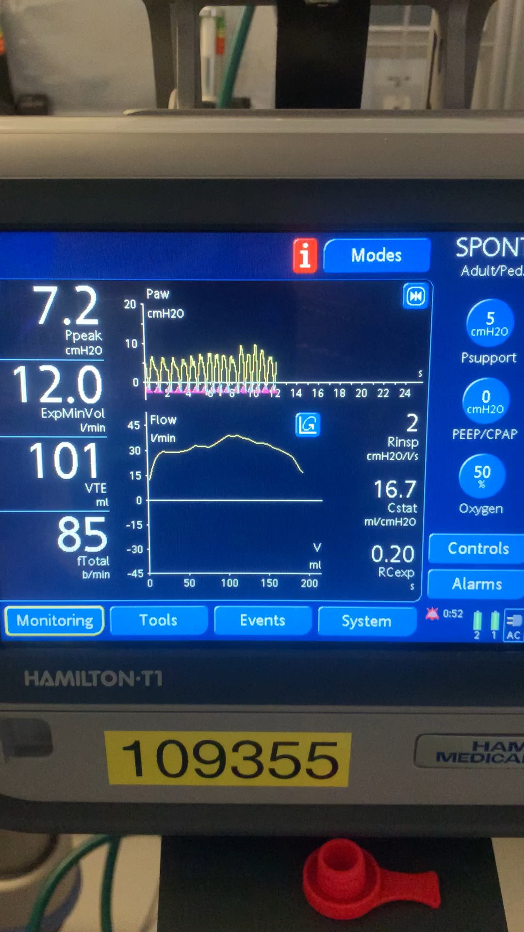
Physiologic Testing:

Slide 13
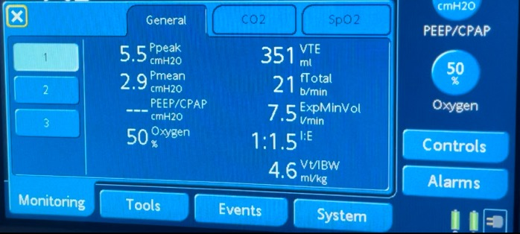
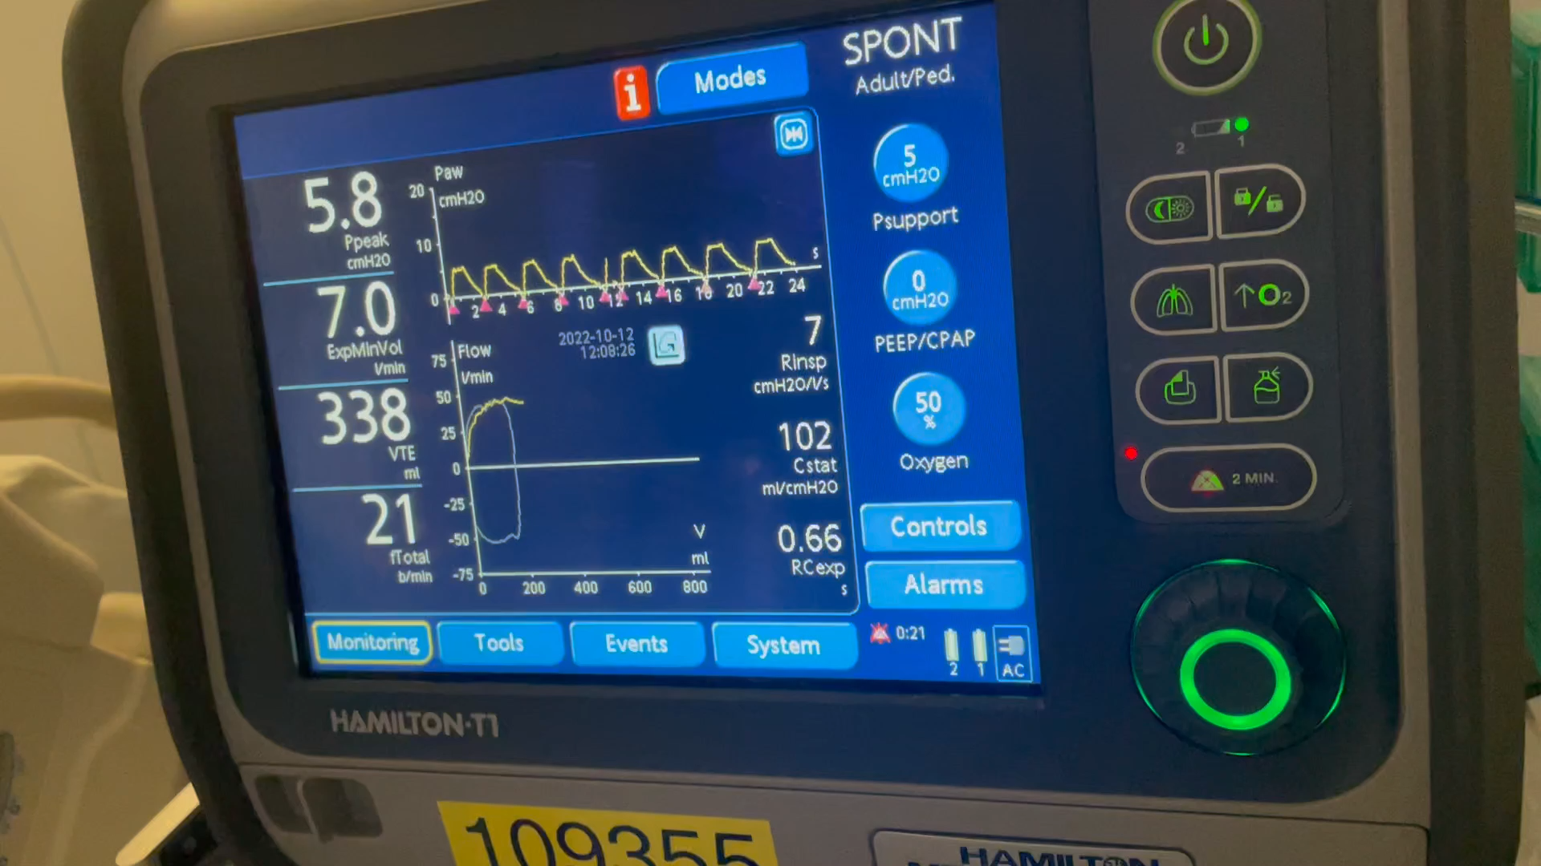
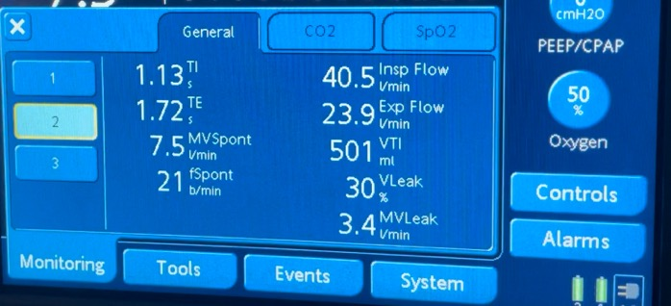
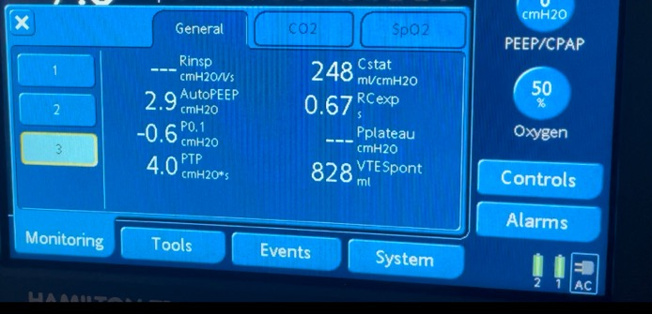
Physiologic Testing: Precedex, Seated +30

Slide 14
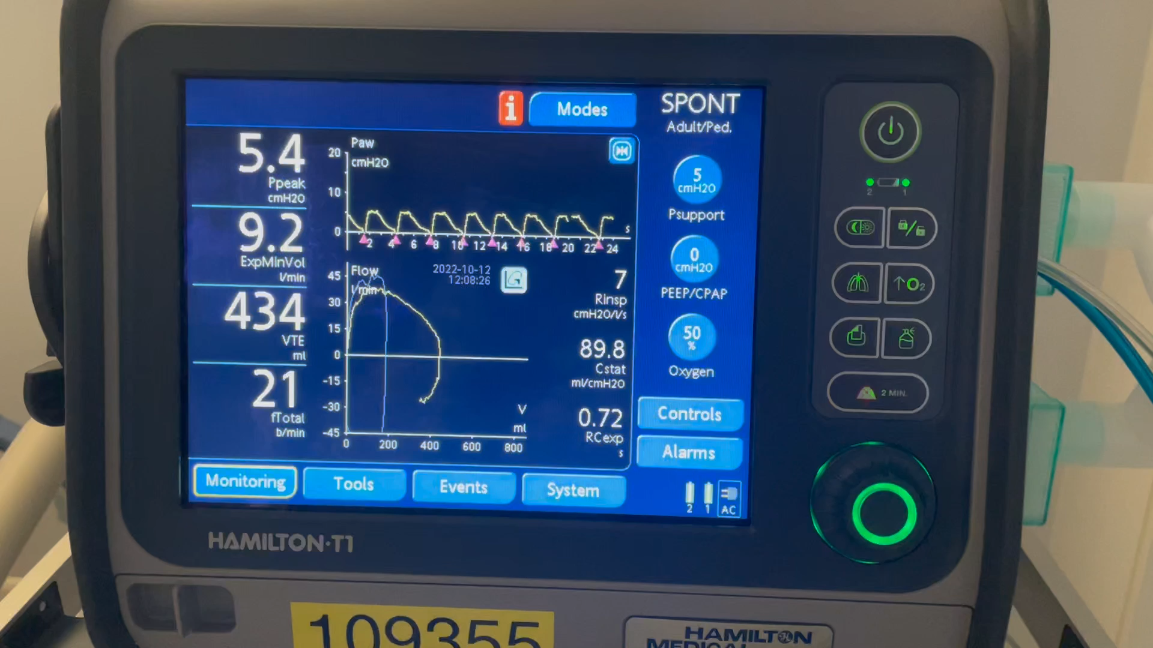
Physiologic Testing: Precedex, Supine

Slide 15
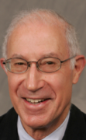
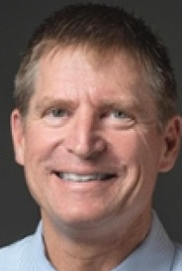

Why can this patient not lie flat, even while on BPAP?
Does/did this patient really have both TBM and laryngospasm? Why?
Is the tracheostomy helping or hurting?
Does this patient still have sleep apnea?
Why does he develop ‘guppy breathing’
What workup do y’all want to figure out what to do?
Applied Respiratory Physiology

Slide 16
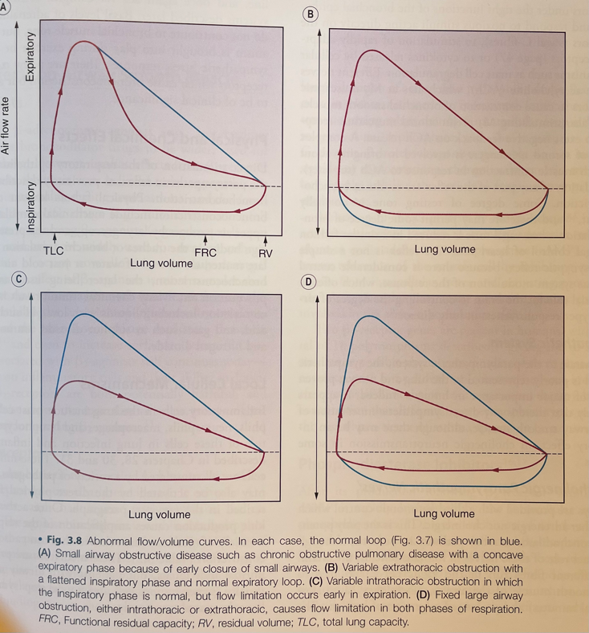
Is this sleep apnea?
Definitely obstructive, probabe hypopneas
Any relation to sleep? (supine/seated)
Anatomic propensity to airway collapse
Dilator Muscle Control (ish – membraneous trachea has smooth muscle)
Sleep Arousal Threshold
Ventilatory Control (opposite influence)
TBM | OSA
Obstruction during exhalation | Obstruction during inhalation
Increased intrathoracic pressure during episodes | Decreased intrathoracic pressure during episodes
Pneumatic splint (PEEP) works | Pneumatic splint (PEEP) works

Slide 17
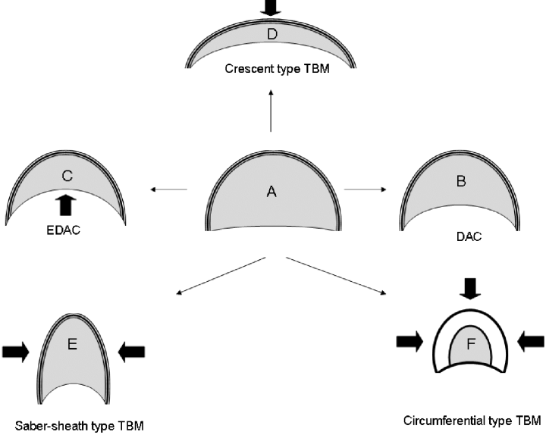
Re: laryngospasm and tracheostomy?
Methods to increase end-expiratory pressure are adaptive
Pursed lip breathing
Laryngospasm (exh?)
Tracheostomy’s influence on PEEP?
He thinks it helped (diagnosis by therapeutic response is challenging)
Currently in place to help facilitate mucus secretions…

Slide 18
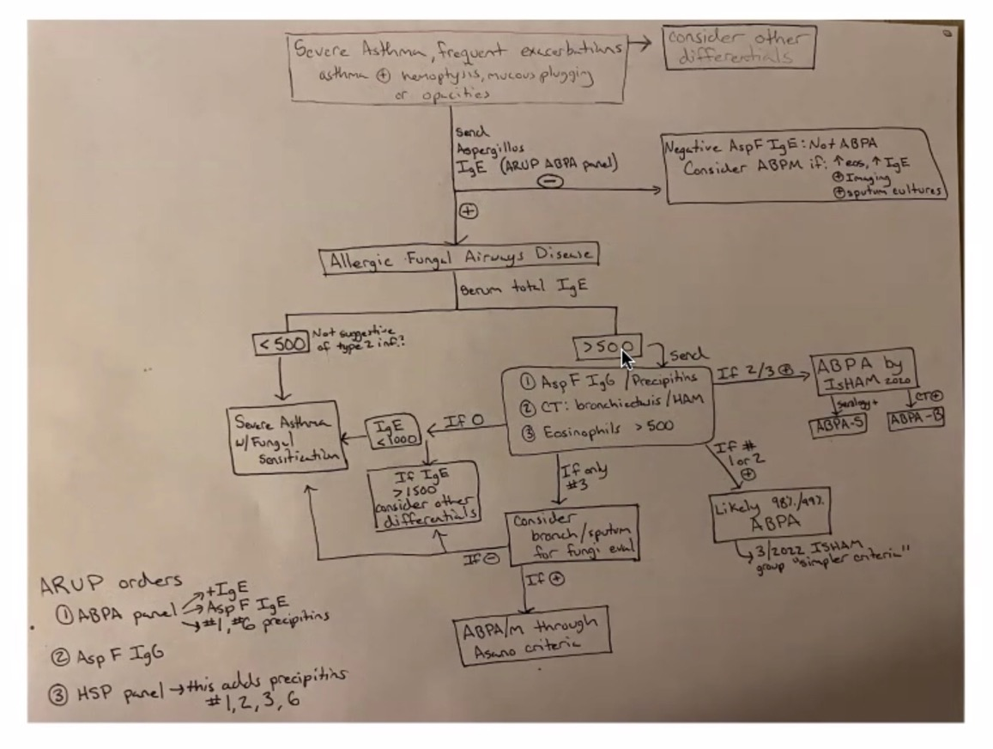
Graham J. Annals of PGR (2022)
ISHAM Criteria for ABPA-S
Existing Asthma dx
Imaging limited, no known bronchiectasis but definitely large volume mucus
Aspergillus on cx
On 10mg+ prednisone
IgE 1200 (x2)
Eos 300ish range (x many)

Slide 19
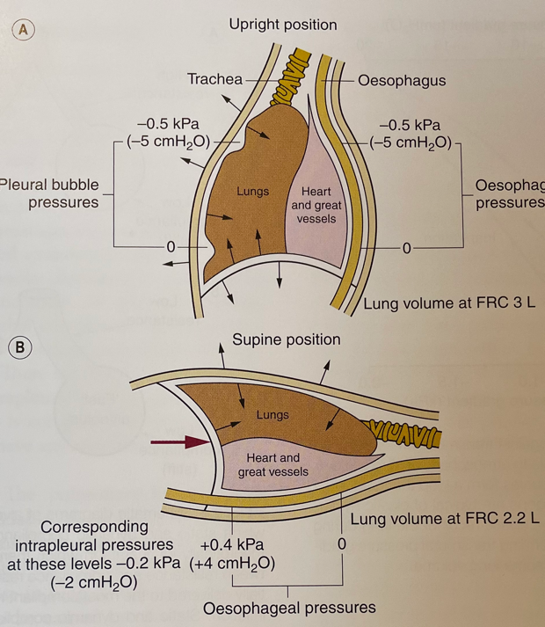
Why Orthopnea?
Usual mechanisms of orthopnea
Increased venous return
Upward displacement of abdomen
Increased diaphragm dependence
Could increased superior intrapleural pressure cause collapse?
… but would sedation change?

Slide 20

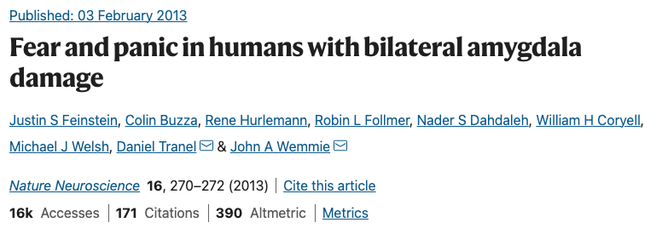
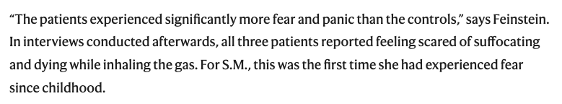
Why Orthopnea?
Patient S.M. 44F bilateral amygdala destruction due to Urbach-Wiethe Dz
No experience of fear in everyday life or conventional experimental stimuli (e.g. exposure to large spiders) since childhood
FiCO2 35% → panic
Fear from air hunger bypasses amygdala
We don’t fear asphyxiation the same way we fear anything else
Notes:
they had worse panic -> possibly the amygdala normally inhibits panic (or modulates it somehow.

Slide 21
Air Hunger: Risk of PTSD?
55 survivors of torture: asphyxiation (waterboarding) strongest predictor of PTSD
No ceiling effect (risk of PTSD) to repeat episodes: nearly unique
279 survivors of torture in Eastern block: uncontrollability leads to hopelessness, second most aversive (only after rape)
DyStress – REVA Network prospective cohort
2016-2018; N=612. Patients requiring 24+ hrs of IMV, enrolled once able to communicate. Assessed daily
762 assessed but not enrolled – mostly couldn’t communicate.
Exposure: “Are you having trouble breathing now”, 0-10 VAS to quantify
Choose between: air hunger, excessive respiratory effort. Also, anxiety+pain
Outcomes: 34% dyspnea @ enrollment (71% air hunger), severity 5
ICU LOS: 6d vs 6d for dyspneic and non-dyspneic
90d interview: PTSD – 29% vs 13%; rate highest in patients choosing “Air Hunger”
Independently associated in multivariable model (OR 2.47) account for other chars
Limitation: unknown if the rate of dyspnea (or recollection) is ↑ or ↓ in patients unable to communicate.
Notes:
https://www.atsjournals.org/doi/abs/10.1164/rccm.202108-1857OC
Evolutionarily, this makes sense. - incredibly aversive stimulus. In fact –
Başoğlu M
. Waterboarding is severe torture: Research findings. Mass Trauma, Mental Health & Human Rights. https://metinbasoglu.wordpress.com/2012/12/25/waterboarding-is-severe-torture-research-findings/ Date last updated: December 25, 2012. Date last accessed: August 27, 2016.
Google Scholar
↵Başoğlu M,
Livanou M,
Crnobarić C
. Torture vs other cruel, inhuman, and degrading treatment: Is the distinction real or apparent? Arch Gen Psychiatry 2007; 64: 277–285.
CrossRefPubMedGoogle Scholar
↵Başoğlu M,
Mineka S
. The role of uncontrollable and unpredictable stress in post-traumatic stress responses in torture survivors. In: Başoğlu M, ed. Torture and its Consequences: Current Treatment Approaches. Cambridge, Cambridge University Press, 1992; pp. 182–225.

Slide 22
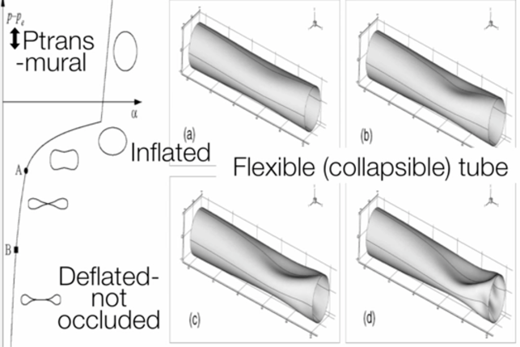
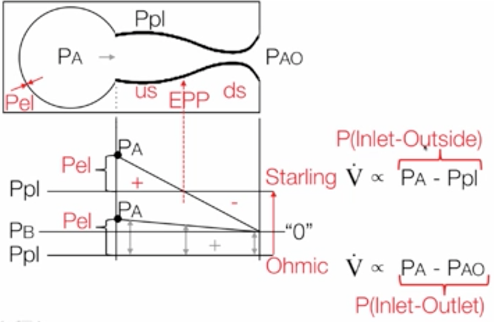
Does Starling Explain This?
Review: Effort independent portion of exhalation curve – increases in driving pressure no longer increase flow
Starling: airway collapses whenever P_outside > P_inside
Quiet breathing -> Ohmic resistor (intrapleural pressure remains subatmospheric or close, airway remains stented open)
Forced exhalation -> Starling resistor (muscle activity increases intrapleural pressure = earlier collapse of the airway)
Equal Pressure Point:
Upstream, airway behaves like an Ohmic resistor
Downstream, airway behaves like a Starling Resistor
Normal airway: some limit to maximal “Starling-ness”
TBM: no limit? Would not lead to full flow cessation, but may reduce flow
Notes:
- https://onlinelibrary.wiley.com/doi/full/10.1111/j.1440-1843.2006.00862.x

Slide 23
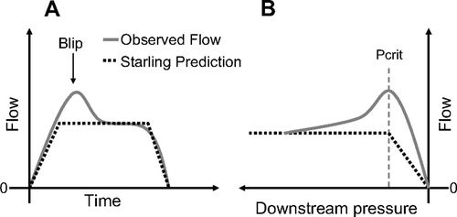
Negative effort dependence
Starling model predicts no effort dependence.
In practice, negative effort dependence is observed (~50% of airway obstruction events for OSA)
Flow-mediated suction? Tissue folding? Greater proportional obstruction of mucus?

Slide 24
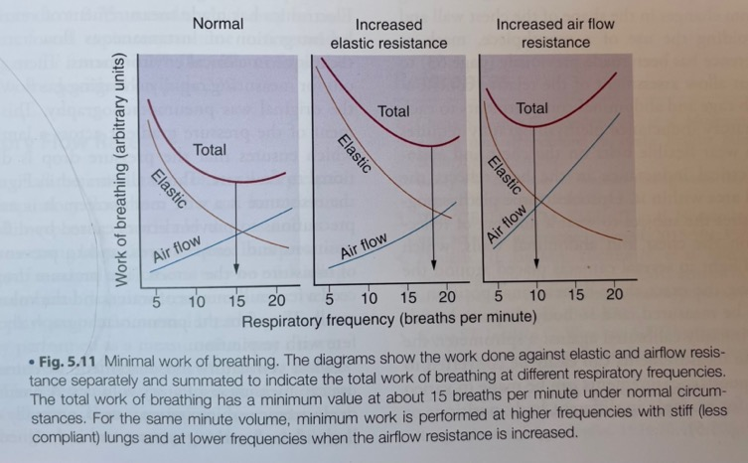
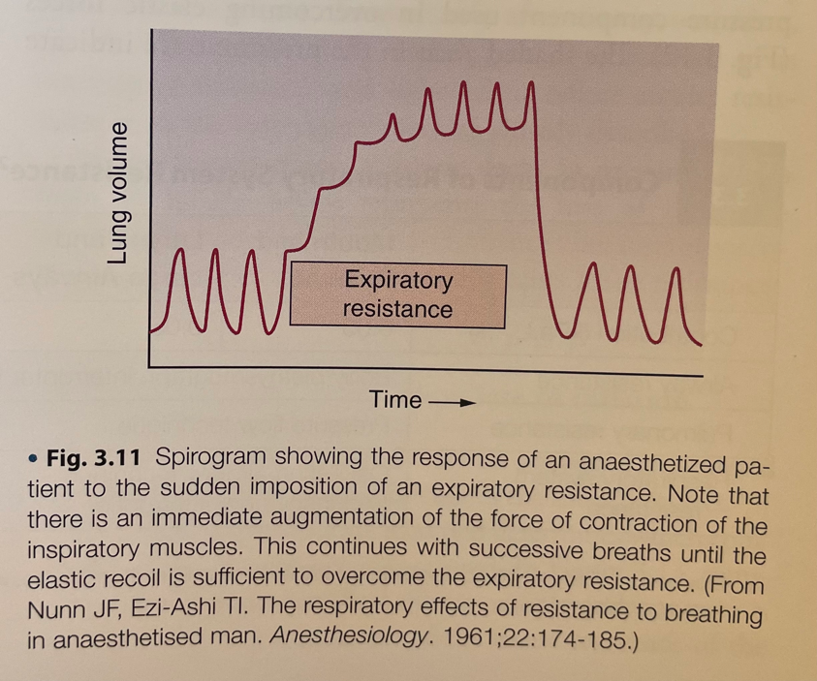
Why ‘Guppy Breathing’
Dynamic hyper-inflation
Elevated work for same Ve
Mal-adaptive response

Slide 25
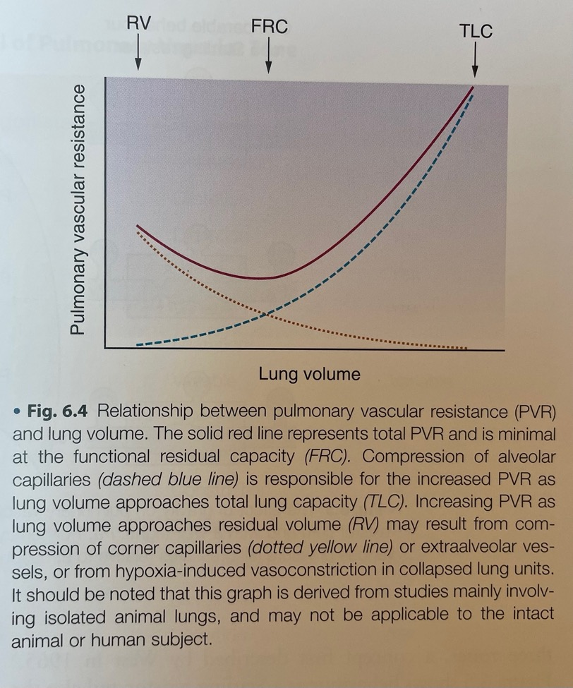
Why Torsemide?
Totally normal echo
Periodic increase in RV afterload?
Opposite effect of classic Post-obstructive Pulmonary Edema/POPE (positive, not negative, intrathoracic pressure)
Clear lungs, but congested right heart?
Notes:
Cardiovascular collapse? Ppl >= PA > PaOutlet -> flow = 0.
Starling: PA > Ppl > PaOutlet
Ohmic PA > PaOutlet > PaO

Slide 26
What do we do?
CBT (rather unique skillset needed; pulmonary rehab has been counterproductive)
Downsize / decannulate tracheostomy?
Mepolizumab? (or higher dose pred & antifungal)
Revisit tracheoplasty?

